Slide 1

TravelTide
Customer Retention
Creating Customer Segmentation to align with Perks

Slide 2
Content
TravelTide the Task & Data Foundation
  TravelTide & the Task
  TravelTide’s Data
  First Steps – Cleaning and Aggregation
Business Insights
  Distributions
  Percentages of qualitative Values
  Correlations
Segments & Perks
  RFM Personas
  Customer Personas
  ML-Clustering
  Perks
Recommended next Steps

Slide 3
1.1. TravelTide & the Task
Offers different AI powered planning helpers:
  Travel Itinerary
  Travel Plan
  Travel Deals
  Travel Guide
Leaves the choice of booking to the customer
Works on large data bases
The task: Face customer retention by segmentizing customers and find fitting perks

Slide 4
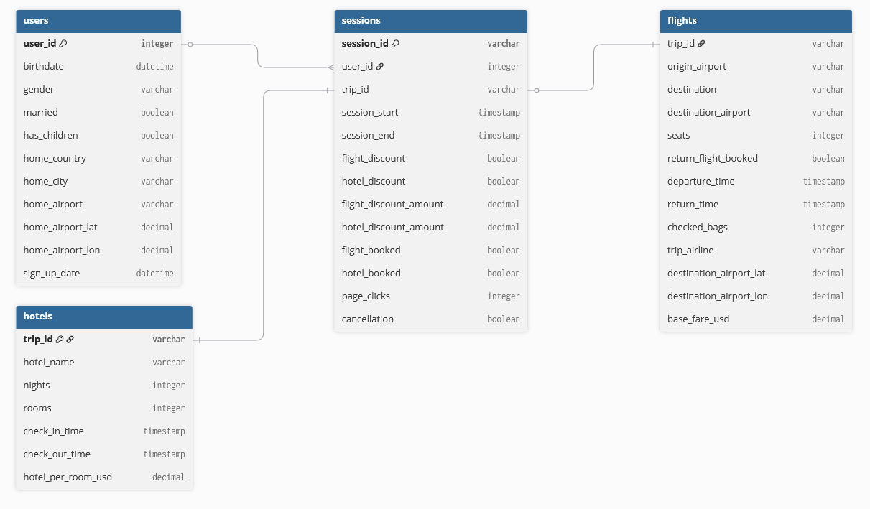
1.2. TravelTide’s Data

Slide 5
1.3. Cleaning & Aggregating
entries with negative count of nights as well as negative time delta between check in and check out times got deleted
An aggregation for users is suitable due to the focus on customers
Filtering users with more than 7 sessions since April 2023
New calculated features:
  Average distance flown
  Age
  Percent of flight without hotel bookings
  Percent of hotel without flight bookings

Slide 6
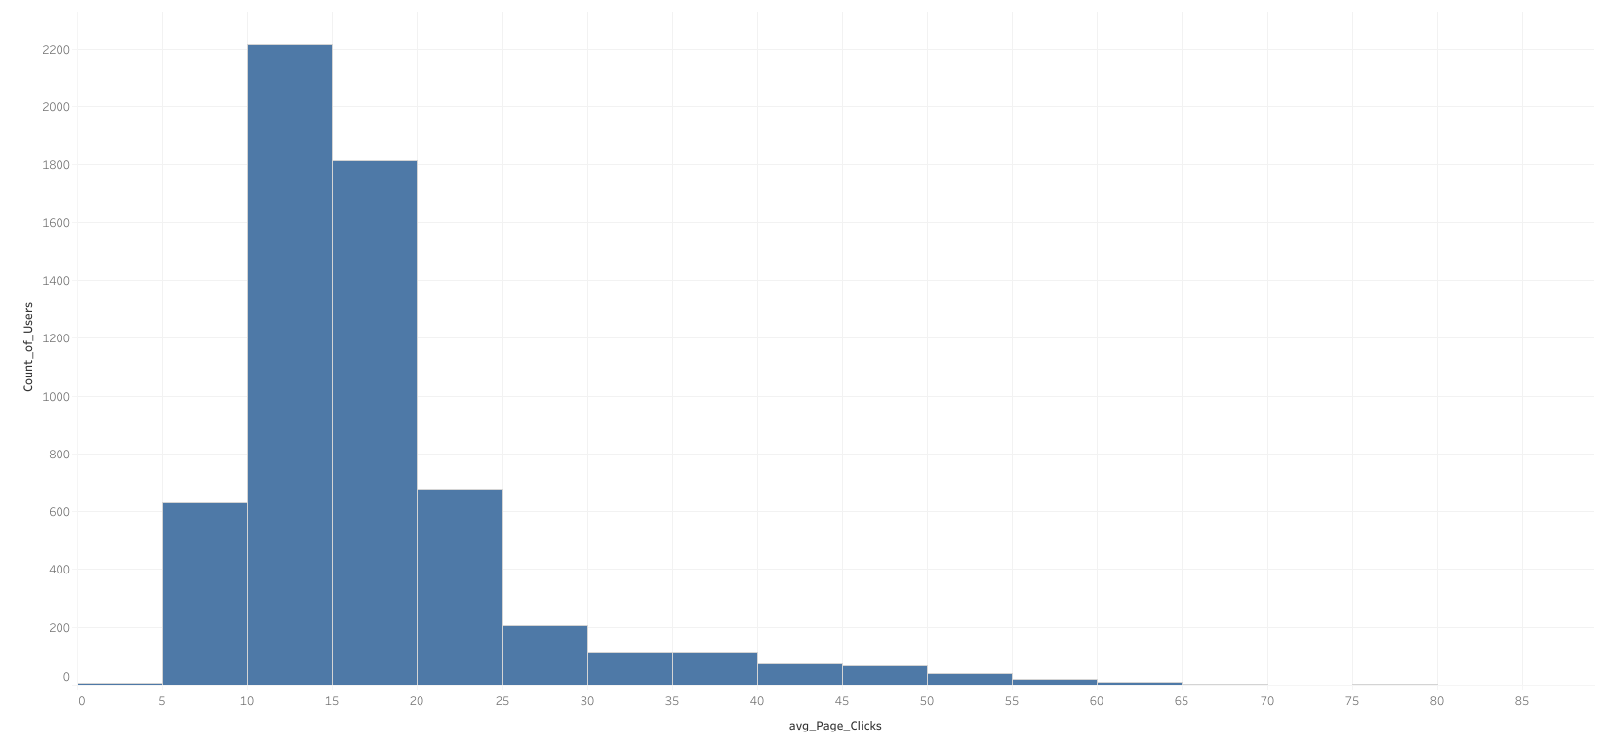
2.1. Distributions - Clicks

Slide 7
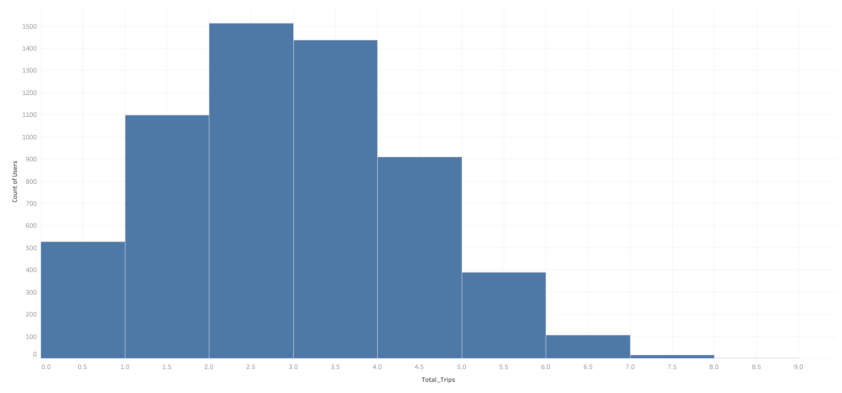
2.1. Distributions - Trips

Slide 8
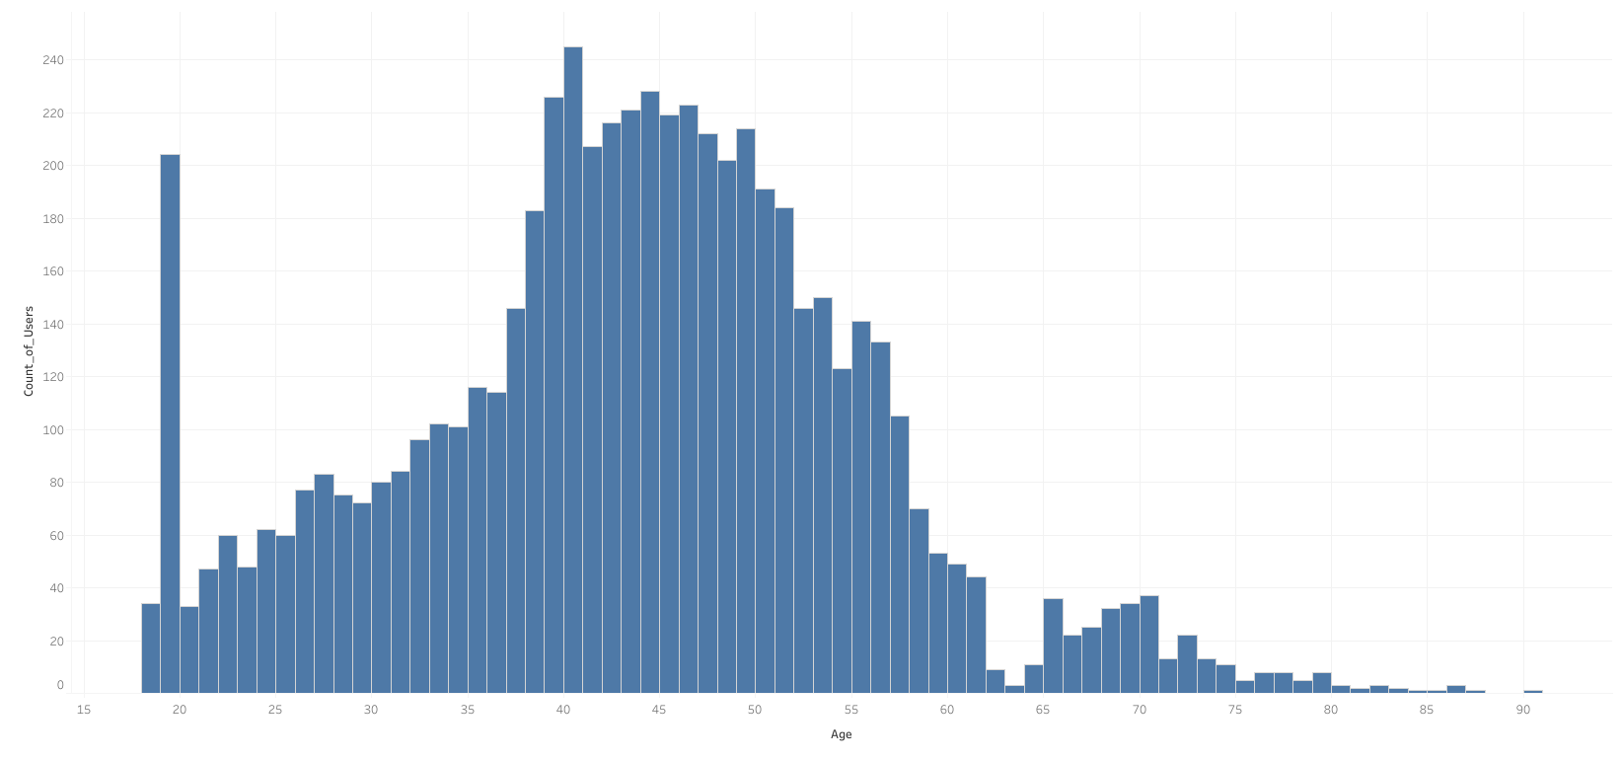
2.1. Distributions - Age

Slide 9
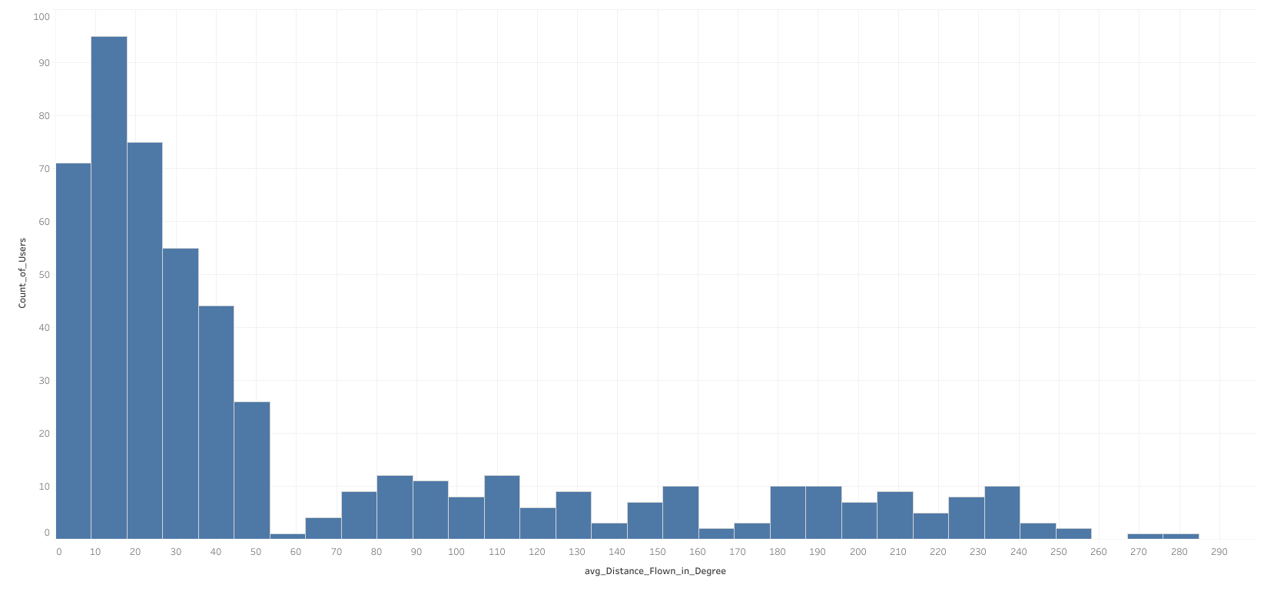
2.1. Distributions - Flight Distance

Slide 10
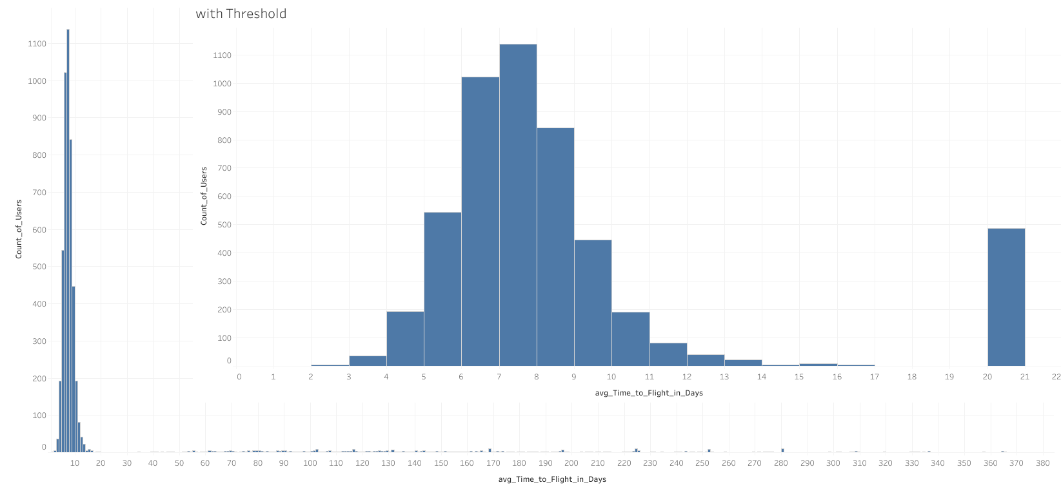
2.1. Distributions - Time to Flight

Slide 11
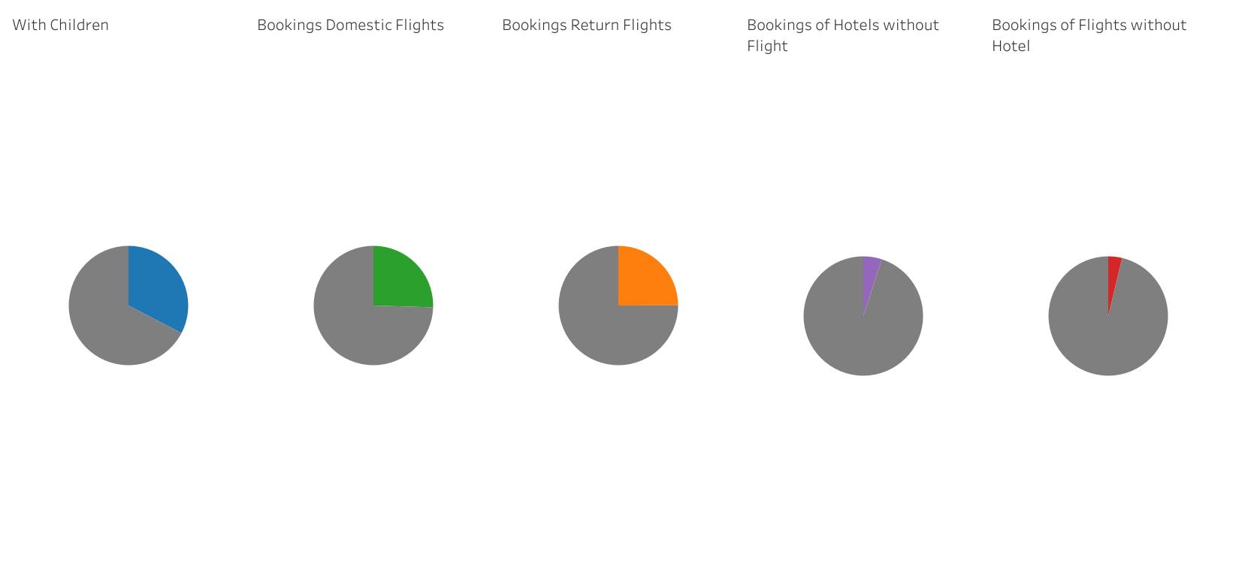
2.2. Percentages of Qualitative Values

Slide 12
2.3. Correlations
Rank | Column_Pair | absolute r_value
1 | base_fare_usd vs rooms | 0.368
2 | base_fare_usd vs nights | 0.206
3 | checked_bags vs base_fare_usd | 0.189
4 | checked_bags vs rooms | 0.096
5 | checked_bags vs nights | 0.068
6 | page_clicks vs base_fare_usd | 0.026
7 | rooms vs hotel_price_per_room_night_usd | 0.016
8 | flight_discount_amount vs hotel_discount_amount | 0.015
9 | hotel_discount_amount vs checked_bags | 0.015
10 | page_clicks vs nights | 0.014

Slide 13
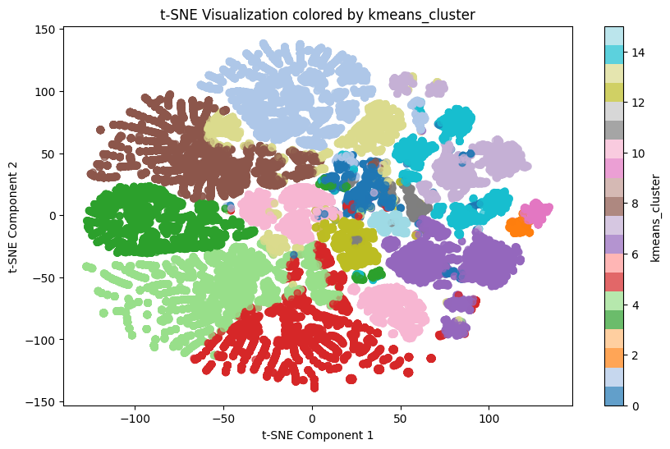
3.1. ML-Clustering

Slide 14
3.2. RFM Personas
Persona (Code Prefix) | Recency (R) | Frequency (F) | Monetary (M) | Simple Description
A True Champions | Perfect (5) | Perfect (5) | Perfect (5) | Highest value, most recent, and most frequent buyers.
B Premium High-Value Recents | Perfect (5) | >= 3 (Medium/High) | Perfect (5) | High spenders who bought recently, showing strong current value.
B Premium Loyal Recent Buyers | Perfect (5) | Perfect (5) | >= 3 (Medium/High) | Most frequent buyers who bought recently, showing strong loyalty.
B Premium Loyal Big Spenders | >= 3 (Medium/High) | Perfect (5) | Perfect (5) | Highest frequency and spend, but Recency is starting to slip (need re-engagement).
C Champion Contestants | High (4) | High (4) | High (4) | Excellent performers across all metrics, just shy of the "Premium" tier.
C High-Value Recents | >= 4 (High/Perfect) | Any | >= 4 (High/Perfect) | High spenders who made a recent purchase.
C Loyal Recent Buyers | >= 4 (High/Perfect) | >= 4 (High/Perfect) | Any | High frequency customers who made a recent purchase.
C Loyal Big Spenders | Any | >= 4 (High/Perfect) | >= 4 (High/Perfect) | High frequency customers who also spend a lot.
D New & Active | >= 4 (High/Perfect) | Any | Any | Newest customers—R is high, but F & M haven't had time to grow yet.
D Big Spenders | Any | Any | >= 4 (High/Perfect) | Defined solely by high total spending (Monetary value).
D Frequent Visitors | Any | >= 4 (High/Perfect) | Any | Defined solely by high purchase frequency.
E Potential Re-Actives | > 2 (Medium/High) | > 2 (Medium/High) | > 2 (Medium/High) | Scores are not the worst (at least one 3), but they need a prompt to return to higher tiers.
F Churn Risk | <= 2 (Low) | <= 2 (Low) | <= 2 (Low) | Lowest scores across the board. The most likely to stop buying.

Slide 15
3.3. Traveler Personas
Customer Persona | Key Defining Condition(s)
Family Vacationer | Has Children AND High Rooms Taken AND High Seats Booked
Leisure Planner | High Time to Flight AND High Nights Stayed AND High Rooms Taken
Young Traveler | Age < 30 AND Frequent Traveler
Established Professional | Age 35 to 63 AND High Flight Spending AND Low Nights Stayed
Value Shopper | High Page Clicks AND Rare Traveler
Demanding Customer | High Checked Bags AND High Page Clicks
Discount-Skeptic | Low Flight Discount Taken AND Low Hotel Discount Taken
Business Traveler | Frequent Traveler AND Low Nights Stayed
Last-Minute Voyager | Low Time to Flight AND Low Return Flight Booked Percentage
Bargain Hunter | High Flight Discount Taken AND High Hotel Discount Taken
Domestic Driver | High Percentage of Domestic Flights AND High Percentage of Hotels w/o Flights
Driver | High Percentage of Hotels w/o Flights
Domestic Voyager | High Percentage of Domestic Flights
Globetrotter | Low Percentage of Domestic Flights
Instant-Buyer | Low Page Clicks
Private Bed | High Percentage of Flights w/o Hotels
Frequent Leisure Traveler (Fallback) | Frequent Traveler (if no other rule applies)
Rare Traveler (Fallback) | Rare Traveler (if no other rule applies)
Others (Fallback) | None of the above rules apply

Slide 16
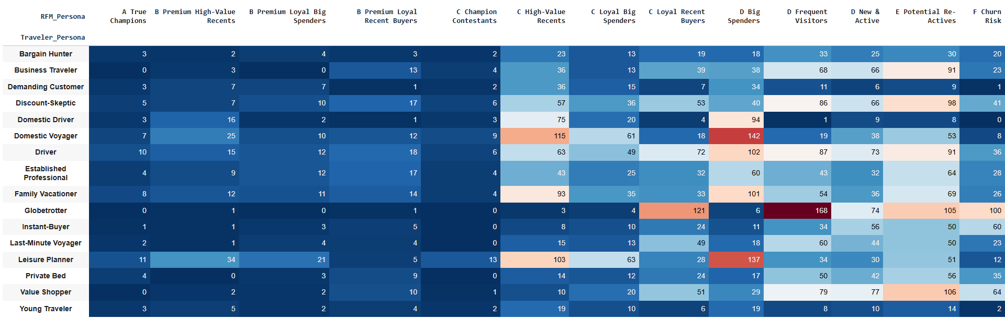
3.4. Customer Personas

Slide 17
3.5. Perks
Bargain Hunter: Flexible Booking Discount
Business Traveler: Complimentary/Discounted Class Upgrade
Demanding Customer: Premium Service Add-ons *
Discount-Skeptic: automatic Cashback Rewards
Domestic Voyager: Ground Transport Discount
Domestic Driver: flight + Ground Transport Discount
Driver: flight + Ground Transport Discount
Established Professional: Hotel Experience Vouchers
Family Vacationer: Family Rate Perk
Globetrotter: Bonus Loyalty Points/Miles
Instant-Buyer: Instant-Booking Rewards
Last-Minute Voyager: Flash Deals Access
Leisure Planner: Accumulative Loyalty Discount
Private Bed: flight discount/Premium Service Add-ons *
Value Shopper: Accumulative Loyalty Discount
Young Traveler: Destination Experience Perks
*Complimentary checked baggage or priority check-in/boarding

Slide 18
4. Recommended next Steps
Gather data on the customer response to the perks
A/B testing with different perks connected with different fitting personas
Try different perks on customers that did not respond to the first perk
Check for correlation between perks and ML-clusters
Implement supervised classification ML-models

